Slide 1
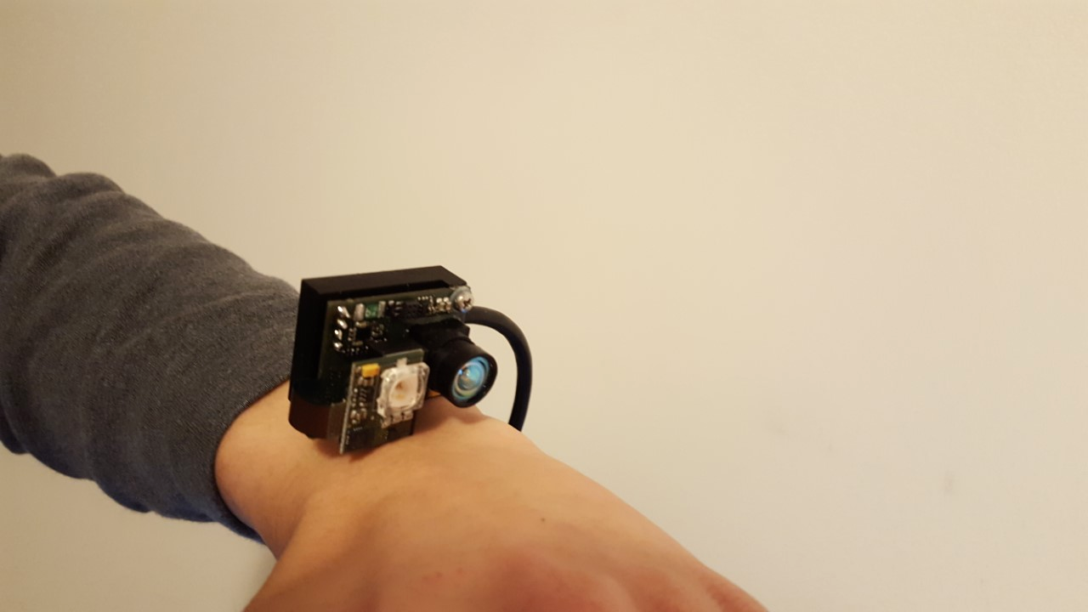
GRIDS: Gesture Recognition via Infrared & Depth Sensing
Wei Yang Quek
Gabriel Reyes
Kshitish Deo
Advisors:
W. Keith Edwards Thad Starner Gregory D. Abowd
Notes:
Today, I will be presenting my research on GRID, gesture Recognition via infrared and depth detection

Slide 2
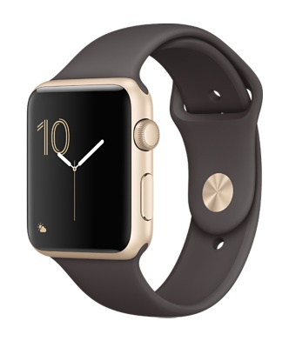
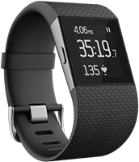
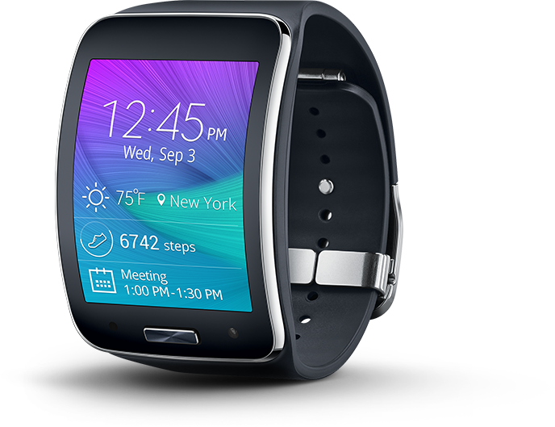
Problem
Size on small surfaces
Occlusion and fat finger problem
Speech (privacy & noise)
Capacitive touch of screens
Notes:
1:02 0:40
With our current technology, our current modes of interaction is through touch, tap and drag. There are problems associated with this, especially with the small size of wearables in the market.
One is Occulsion. Once our finger enters the interaction zone, we cannot see much of where we are tapping. This also relates to the fat finger problem where our fingers are usually bigger than the buttons we are clicking and we end up clicking the wrong one.
One alternative is using speech. However, it usually doesn’t work when theres alot of ambient noise and usually makes for awkward encounters with potential breaches of privacy.
Then, there is the problem of using gloves on touch screen which sparked people to start selling touchscreen gloves. Since touch screens generally use capacitive technology, people will find it difficult to use their watch or phones if their hands are wet or while wearing gloves.

Slide 3
Solution Overview
Dimensions of interactivity
Increase the surface area of possible interaction by extending out to the skin
Increase the volume of the possible interaction space
Notes:
1:17 1:00
The biggest way we can counter this problem is to expand the interaction space.
To overcome the occlusion and fat finger problem, we have to somehow increase the area of interaction. Alternatively, we could also increase the dimensions of interaction.

Slide 4
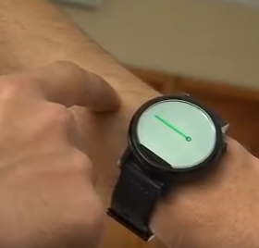
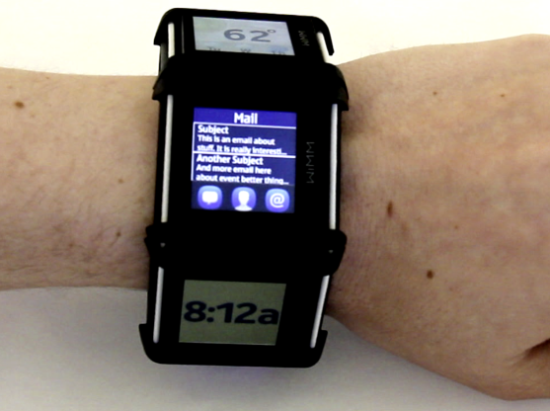
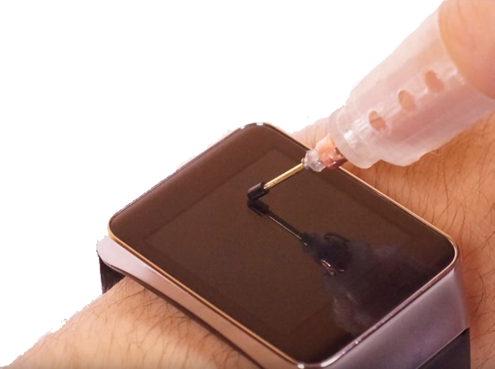
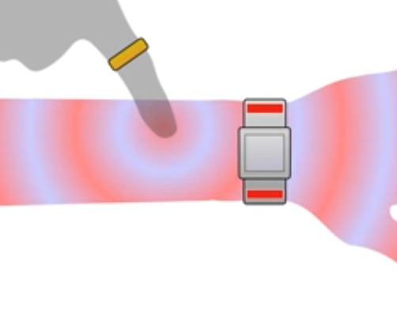
Related Work
Facet UIST 2012 Lyons et. al.
NanoStylus UIST 2015 Xia et. al.
SkinTrack CHI 2016 Zhang et. al.
FingerIO CHI 2016 Nandakumar et. al.
Notes:
2:20 2:00
CUT DOWN
What do I mean. Lets take a look at some of the research that have come out very recently.
In 2012, Kent Lyons published his research on Facet, where he came up with the most intuitive solution to solve the small size of interaction surface. His solution was to increase the number of screens such that the screens surrounds the user’s wrist.
However, we can see that this is bulky and definitely expensive.
In 2015, a few people from Autodesk integrated a solution used in tablet and phones on watches - a stylus. This isn’t exactly bulky, but not many people would appreciate wearing a pointer thingy on their finger everytime they want to use their watch.
Then people started coming up with more ingenious solutions.
Both in CHI 2016, SkinTrack used the electric signals from a ring worn by a user to measure the distance and FingerIO uses echolocation to detect the finger location. While the ring required the user to wear another wearable for it to work, a ring is certainly less troublesome than a pointer but lets try to get rid of that too.
Normal watches uses tactile feedback, FingerIO uses sound. Whats left?

Slide 5
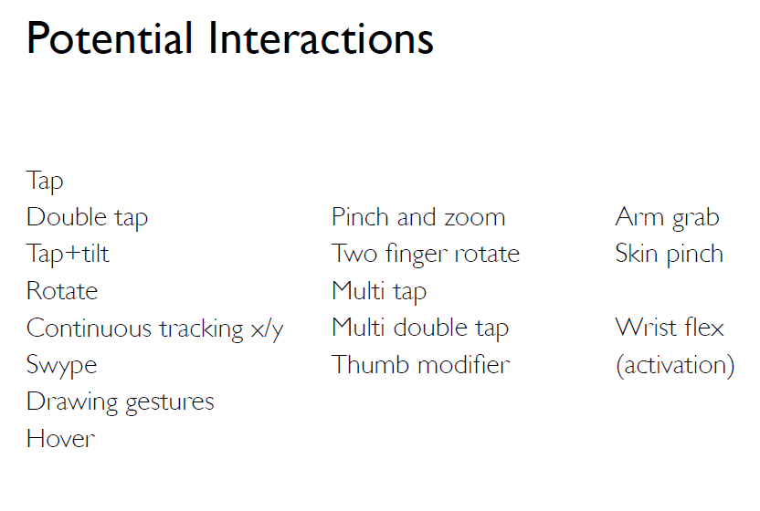
Current Technology
Notes:
3:42
With our curent technology, smart watches allows for this. Some are easier, (the green ones), some harder. But admittedly, still possible.
We want to expand the interactive surface to make existing interactions easier and allow for more of other interactions. In particular, we want to achieve - this (update green and yellow highlights).

Slide 6
Our Technology
Notes:
4:10
The green ones are the ones we managed to achieve, while the light yellow ones are the ones that are easily achievable with the algorithms and techniques that we are currently using. The darker ones are the ones which with a slight extension, will be doable as well.

Slide 7
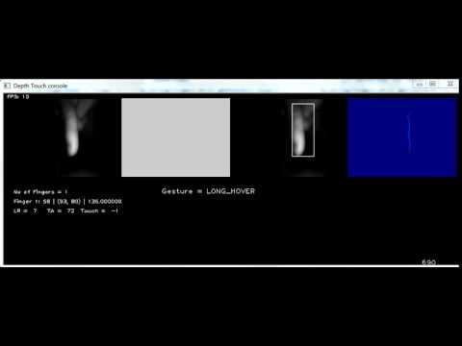
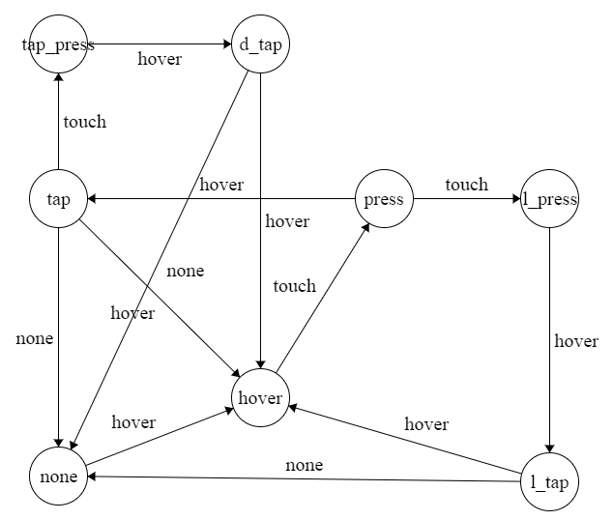
What we managed to achieve (Aaron’s slide)
NONE HOVER / LONG HOVER PRESS / LONG PRESS TAP / LONG TAP TAP & PRESS DOUBLE TAP

Slide 8
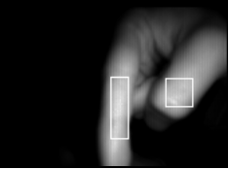
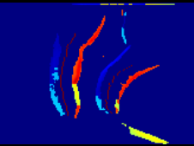
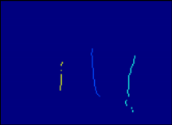
IR Illumination Pipeline
Filtering and Transformation
Setting Interest Region
Detecting Finger
Distinguishing Fingers
Getting Gesture State
Monitoring States
Notes:
6:30
CUT DOWN
We saw that the Depth was noisy. However, the illumination data was much more stable
Filtering -> Rotation & Reflection ->
Setting Interest Region->Getting X Maximal graph -> Finding 80th Percentile of value->Getting Y Maximal Graph->
Getting Depth of Interest Region->
Detecting Finger->Sobel Filtering with Threshold based on Depth-> Getting Direction and Magnitude -> Getting Centers ->
Distinguishing Fingers -> Local Comparison ->
Monitoring States -> Getting local State and duration ->
Getting Gestures from State -> Using State Diagram

Slide 9
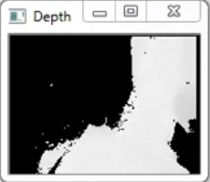
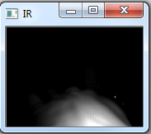
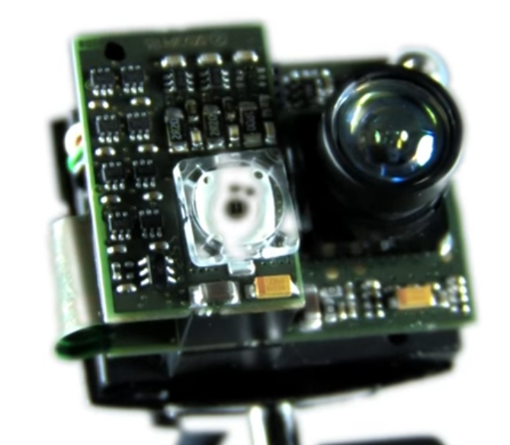
Challenges and Future Work for Aaron And from where we start!!
Using Depth Map
Curvature of Hand
FPS and Pipeline
Smartwatch Integration
Problems of illumination:
Curvature of hand is very poor!
Dont know where my finger is! How far it is? Is it touching the hand?
What if user tilts the hand up?
Notes:
9 -9.45
There were a number of challenges faced in this research.
Depth map is noisy, will add to our recognition, integrate illumination+depth
We started off using the depth which we obtain a fairly good result for several gestures and detections which we showed in the GVU showcase. However, meeting our goal proved challenging due to the amount of noise in the depth sensing, especially at close proximity. To solve this problem, we decided to make use of the illumination which we observed had much stabler inputs.
(Now that illumination has worked to quite a good degree, I believe that the next step is to filter depth (if possible) and integrate the two to improve recognition.
One idea I had was to use the depth mean of the interest region detected to compare against the amplitude depth to either improve recognition results. Together, it may help to stabilise the detection of the coordinates of the finger detected
)
Secondly, there was the characteristic of our intended interaction platform, i.e. the hand. For one, the curvature of the hand caused some parts of the hand to be less illuminated than others. This cause occasional wrong detection of the gesture state.
Lastly, due to the amount of input and computation, lots of processing power was required. Granted, the program wasn’t optimised to its best but several optimisation tricks were done such as multi-threading and tweaking our algorithm to use as many already optimised functions as possible. This latency causes jumpy detections and may sometime break the flow of the states.

Slide 10
Hand from depth frame and finger from Illumination
Depth frame:
Bad mix of finger and hand
BUT GOOD HAND
Illumination frame:
Poor hand
BUT GOOD Fingers

Slide 11
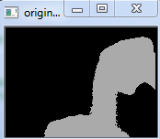
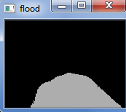
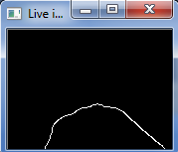
Depth frame of hand
Raw depth image
Removing noise
Distinguishing hand from finger
Contour of the hand
Storing the contour

Slide 12
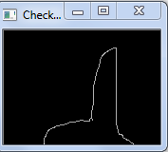
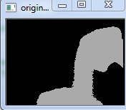
Hand and Finger Problems:
Hand and Finger Solutions:
Even if we consider finger from illumination, depth frame changes
Use the previous depth frame when your fingers come closer
This will freeze the hand when the finger is closer!
Limitation: Movement of hand while tapping or movement of hand while touch movement restricted!
SORRY NO SCREEN SHOT! BOTH HAND TIED WHILE TAKING SCREENSHOT!

Slide 13
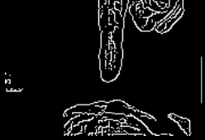
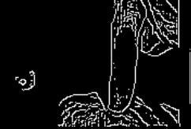
Hand and Finger Problems:
Hand and Finger Solutions:
Contour looks great
But how to recognize it ?
Check area surrounding the color canny tip
Inaccurate tapping detection
Tip detection not possible with color canny

Slide 14
Hand and Finger problem
Hand and Finger Solutions:
2. Tilt :
What if hand is tilted upward.
Finger will infron of the hand but not touch it!
2. Tilt :
Here depth map actually comes into play!!
We can get the depth of each point of hand and lowest point of finger.
Then there is simple calculation!

Slide 15
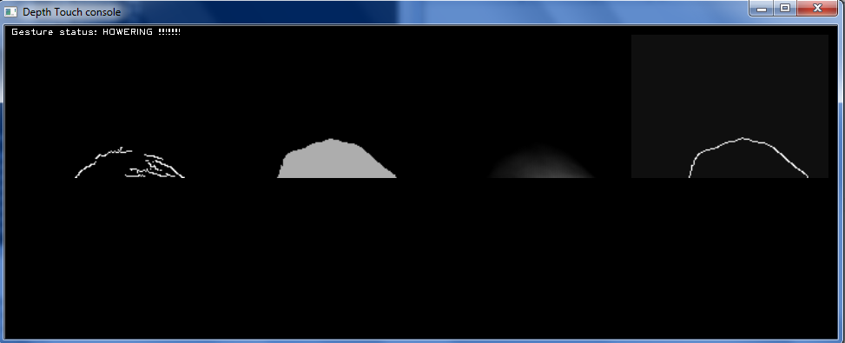
DEMO

Slide 16
Immediate plan (this week):
Hand Tilt problem solving
Increasing the accuracy of tapping using contours coupled with color canny
Spikes problem solving : Freeze the previous frame when spikes come

Slide 17
Future plan:
Checking the accuracy by dividing the hand in grids
Designing applications:
Paint
Calculator
3. Smart watch integration

Slide 18
Summary
Interaction technique using a hybrid IR illumination and depth sensing camera
Demonstrated a number of discrete and continuous gestures
Increase the surface area and volume of interaction
Notes:
10:00
More importantly though, let’s talk about the bigger picture, what does all these mean for us. This expanded forms of interaction changes the way we can interact with our gadget. We no longer are bounded by the 2 dimension surface of our smart watches and this means an exponential increase in the way we can input data.

Slide 19
Related Work
B. R. J. D. F. B. P. B. G. M. Rajinder S. Sodhi, "BeThere: 3D Mobile Collaboration with Spatial Input," in CHI, 2013.
H. B. A. D. W. Chris Harrison, "OmniTouch: Wearable Multitouch Interaction Everywhere," in UIST, Santa Barbara, CA, USA, 2011.
S. H. C. H. Robert Xiao, "DIRECT: Making Touch Tracking on Ordinary Surfaces Practical with Hybrid Depth-Infrared Sensing," in ISS, Niagara Falls, ON, Canada, 2016.
G. P. I. P. Tomasz Klopot, "Optical PMD 3D sensor evaluation for motion detection and tracking application," in IEEE, 2016.
V. S. C. G. B. S. B. I. S. I. Dan Ionescu, "An Infrared-Based Depth Camera for Gesture-Based Control of Virtual Environments," in IEEE, 2013.

